Slide 1
Data Preprocessing
Beiyu Lin

Slide 2
Today’s topic
Data Preprocessing
Exploratory Analysis
Post-processing
Notes:
Data science is the application of computational and statistical techniques to address or gain insight into some problem in the real world.
Computational
Statisticals
Real world problems

Slide 3


The data analysis pipeline
Mining steps
Preprocessing
Data Mining
Post-processing
Preprocessing: real data is noisy, incomplete and inconsistent.
sampling, dimensionality reduction, feature selection.
Post-Processing: make data easy to interpret and useful to users
statistical analysis of importance
visualization.

Slide 4
Data Quality
Data quality problems:
Noise and outliers (example in yellow box)
Missing values (in red box)
Duplicate data (in green box)

Slide 5
Sampling
Why sampling:
obtaining the entire set of data of interest is too expensive or time consuming.
e.g., calculate the average height of a person in Las Vegas?
population in 2019: 634,773
what fraction of tweets in a year contain the word “Greece”?
300M tweets per day, if 100 characters on average, 86.5TB to store all tweets

Slide 6
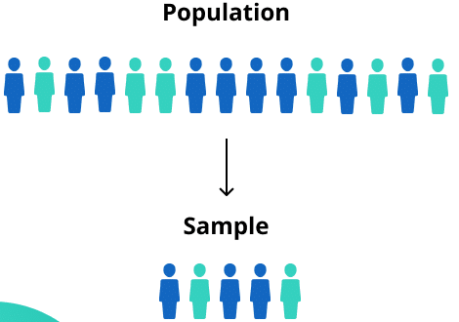
Sampling …
key principles for effective sampling:
using a sample that is representative to estimate the entire data sets
What is a representative sample
if a sample has approximately the same property (of interest) as the original set of entire data
otherwise, the sample introduces some bias
Question: what happens if we take a sample from UNLV to compute the average height of a person in Las Vegas?

Slide 7
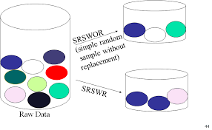
Types of Sampling
Simple Random Sampling
any particular item will be selected with an equal probability
Sampling without replacement
when an item is selected, it is removed
Sampling with replacement
items are not removed when they are selected for the sample
(i.e., the same object can be picked up more than once.)

Slide 8
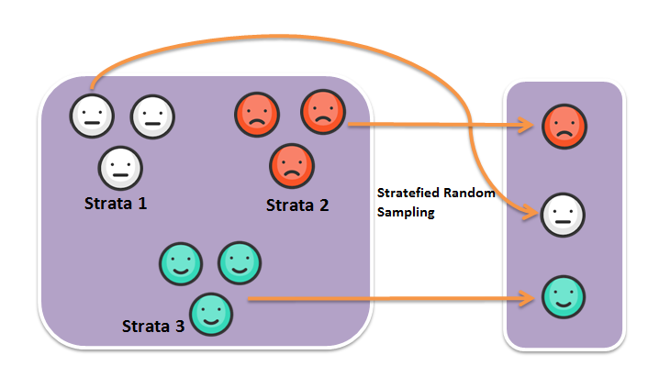


Types of Sampling
Stratified sampling
Split the data into several groups; then draw random samples from each group.
Example: with 0.2% of transactions are fraudulent, how to understand the differences between legitimate and fraudulent credit card transactions?
If I select 500 transactions at random? What would happen?
Solution: ?
Notes:
sample 500 legitimate, 500 fraudulent transactions

Slide 9

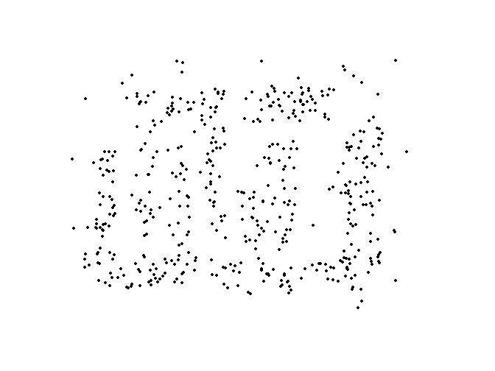
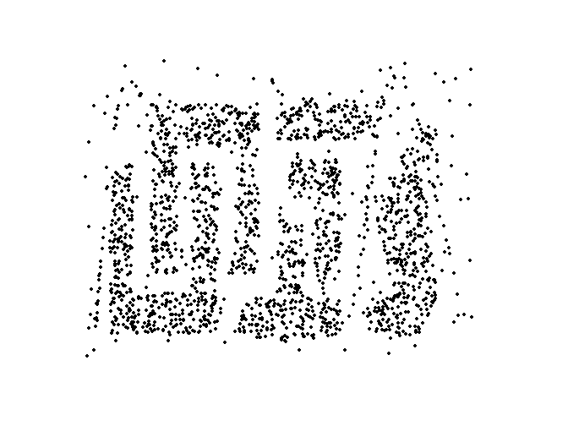


Sample Size
8000 points 2000 Points 500 Points

Slide 10
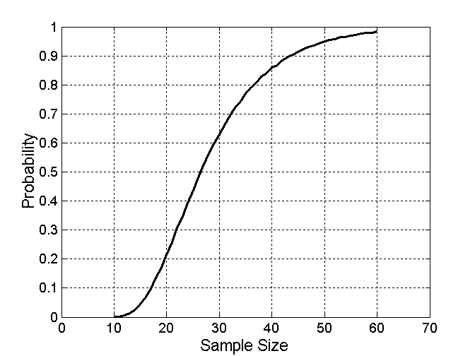

Sample Size
What sample size is necessary to get at least one object from each of 10 fruits.

Slide 11

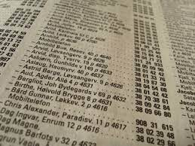
Streaming Data
Names in the phone book
Videos watched by a student in August

Slide 12
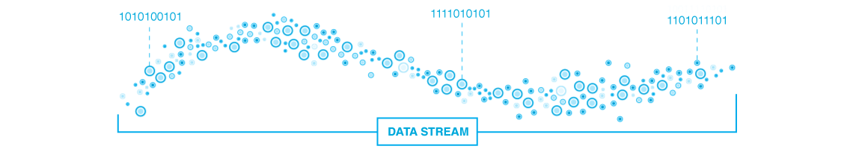
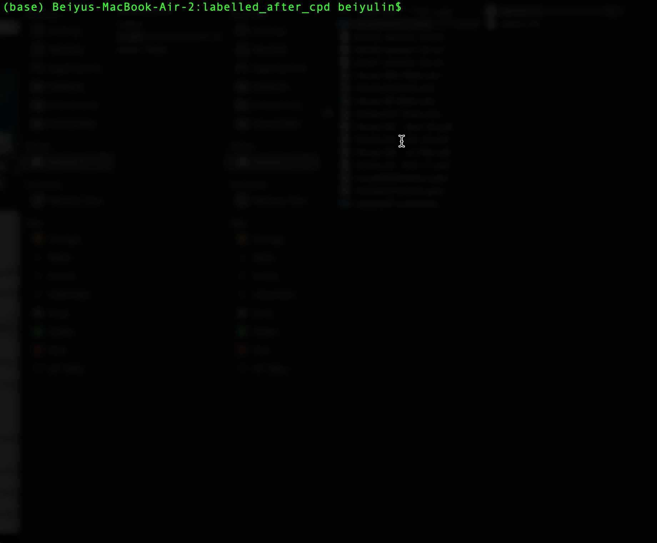
Streaming data

Slide 13


Sampling for streaming data
Task: efficiently return a random sample of 1,000 elements evenly / uniformly distributed from the original stream
Simple solution when the size of stream N is known.
1. generate random integers between 0 and N-1.
2. use the random integer as an index
3. retrieve the elements at those indices

Slide 14

Sampling for streaming data
Task: efficiently return a random sample of 1,000 elements evenly / uniformly distributed from the original stream
What if:
1. the size of the stream N is unknown in advance
2. not enough memory to store the stream in memory
3. only keep a constant amount of integers in memory

Slide 15
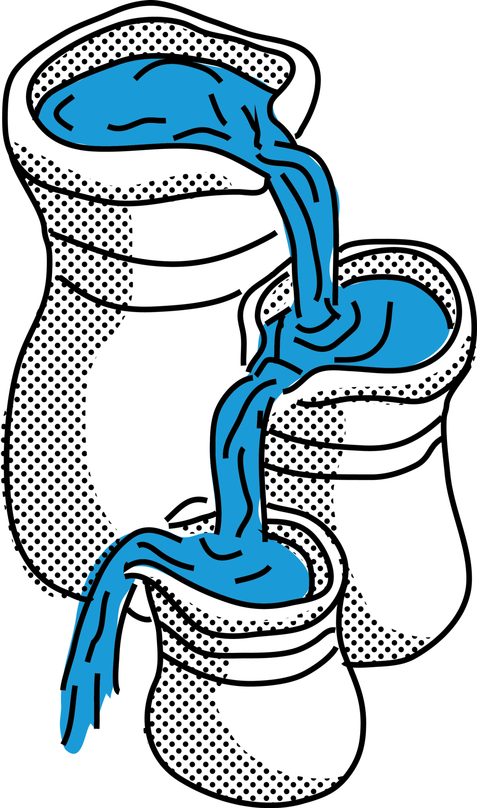

Reservoir sampling
1 | 9 | 2 | 1 | 8 | … | 7
Notes in class
Steps:
1. make a reservoir (array) of 1,000 elements (n = 1,000)
2. fill it with the first 1,000 elements in the stream.
3. process the ith element (i>1,000)
choose to sample the ith item with probability 1,000/i
at the end of processing that step, the 1,000 element in the array / reservoir are randomly sampled amongst the i elements .

Slide 16
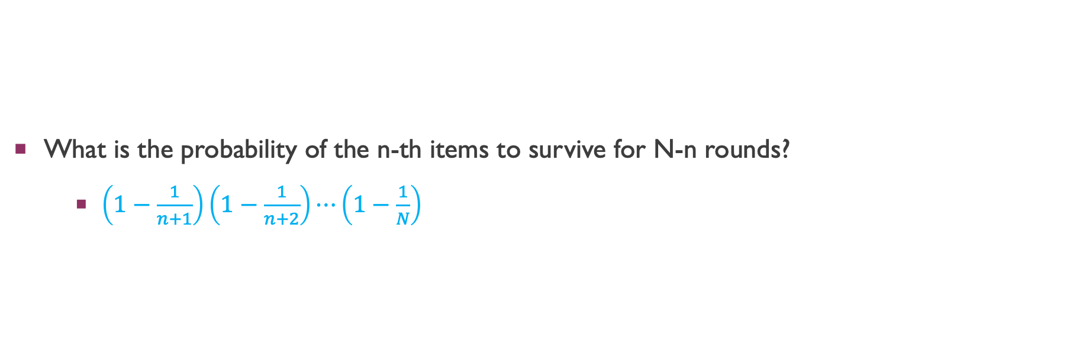
Reservoir sampling
What is the probability of the n-th items to survive for N-n rounds?
$\left(1−\frac{1}{n+1}\right)\left(1−\frac{1}{n+2}\right)⋯\left(1−\frac{1}{N}\right)$

